Slide 2
Infrastructure as Code
or
Let’s build our own infrastructure
by Matjaž Žnidar, Premier Field Engineer at Microsoft

Slide 3
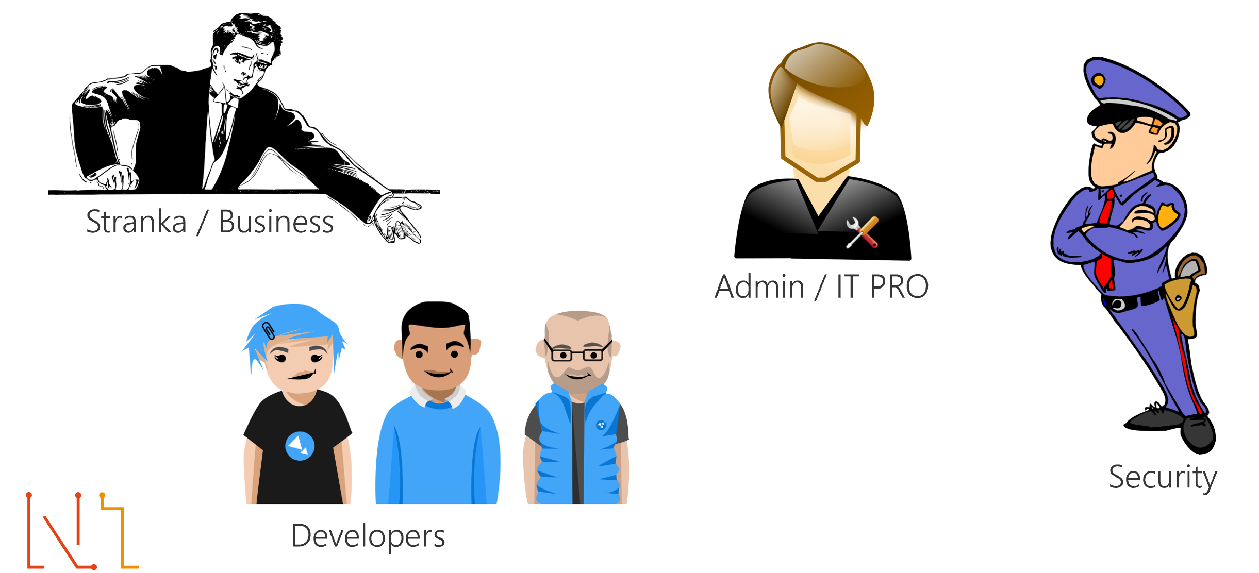

Slide 4
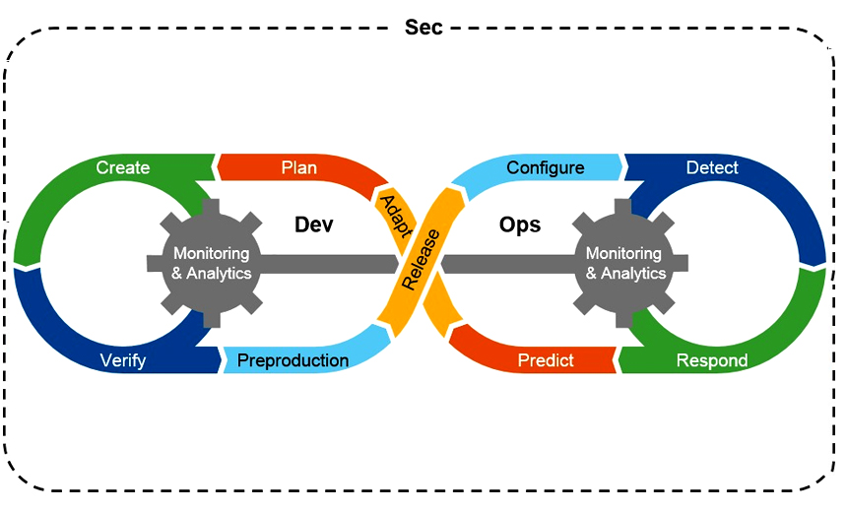

Slide 5
DevSecOps
DevOps is a set of software development practices that combines software development (Dev), information technology security (Sec) and information technology operations (Ops) to shorten the systems development life cycle while delivering features, fixes, and updates frequently in close alignment with business objectives.
Infrastructure as code (IaC)
Infrastructure as code (IaC) is the process of managing and provisioning computer data centers through machine-readable definition files, rather than physical hardware configuration or interactive configuration tools.

Slide 7
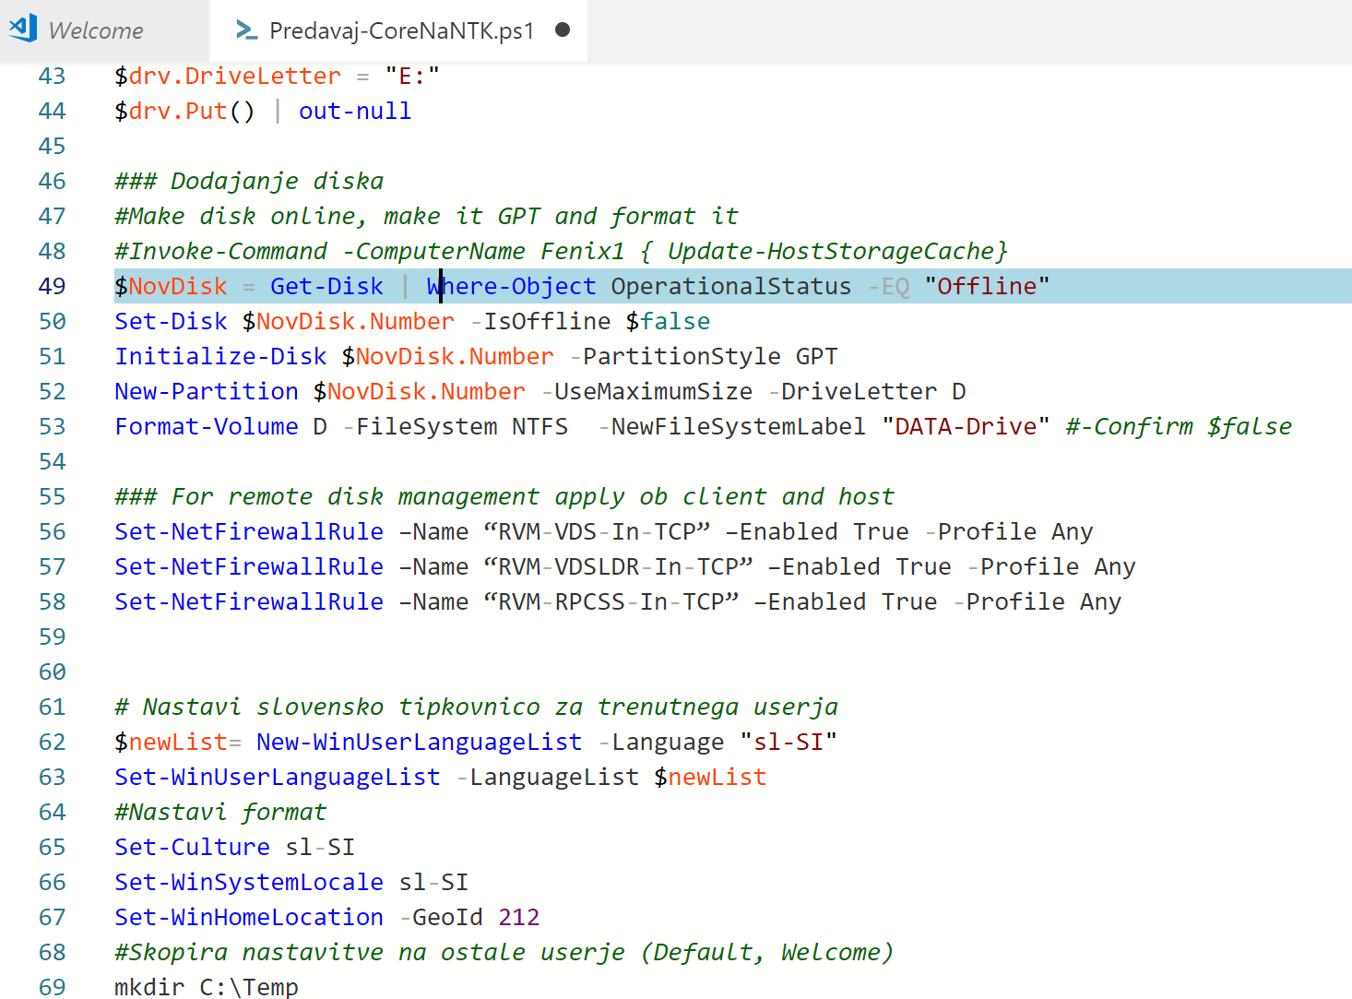

2 principles of IaC
Scripting
Declerative

Slide 8
Continuous integration (CI)
Continuous integration is the practice of merging all developer working copies to a shared mainline several times a day.
Continuous deployment (CD)
Continuous deployment is a software engineering approach in which software functionalities are delivered frequently through automated deployments.
Azure DevOps
Azure DevOps provides development collaboration tools including high-performance pipelines, free private Git repositories, configurable Kanban boards, and extensive automated and continuous testing capabilities.
Terraform (by Hashicorp)
Terraform is an open-source infrastructure as code software tool that enables users to define and provision a datacenter infrastructure using a high-level configuration language known as Hashicorp Configuration Language (HCL), or optionally JSON.

Slide 9
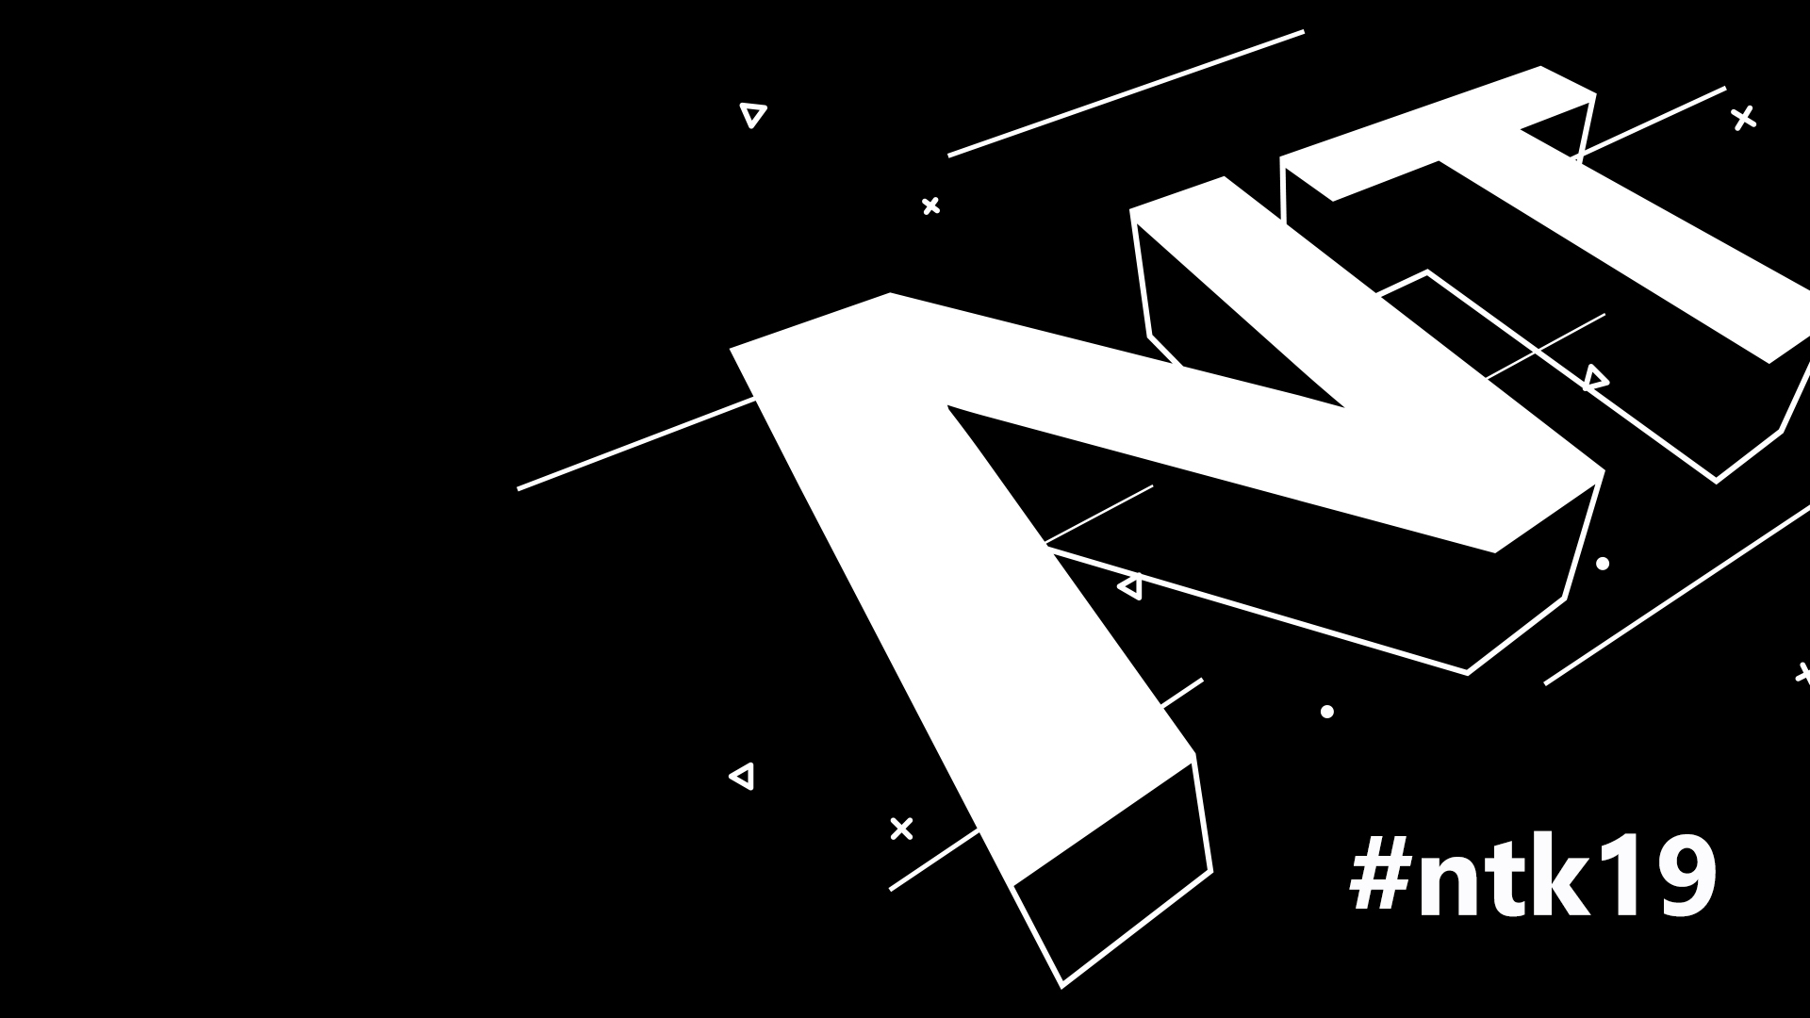
DEMO
Notes:
gasd

Slide 10
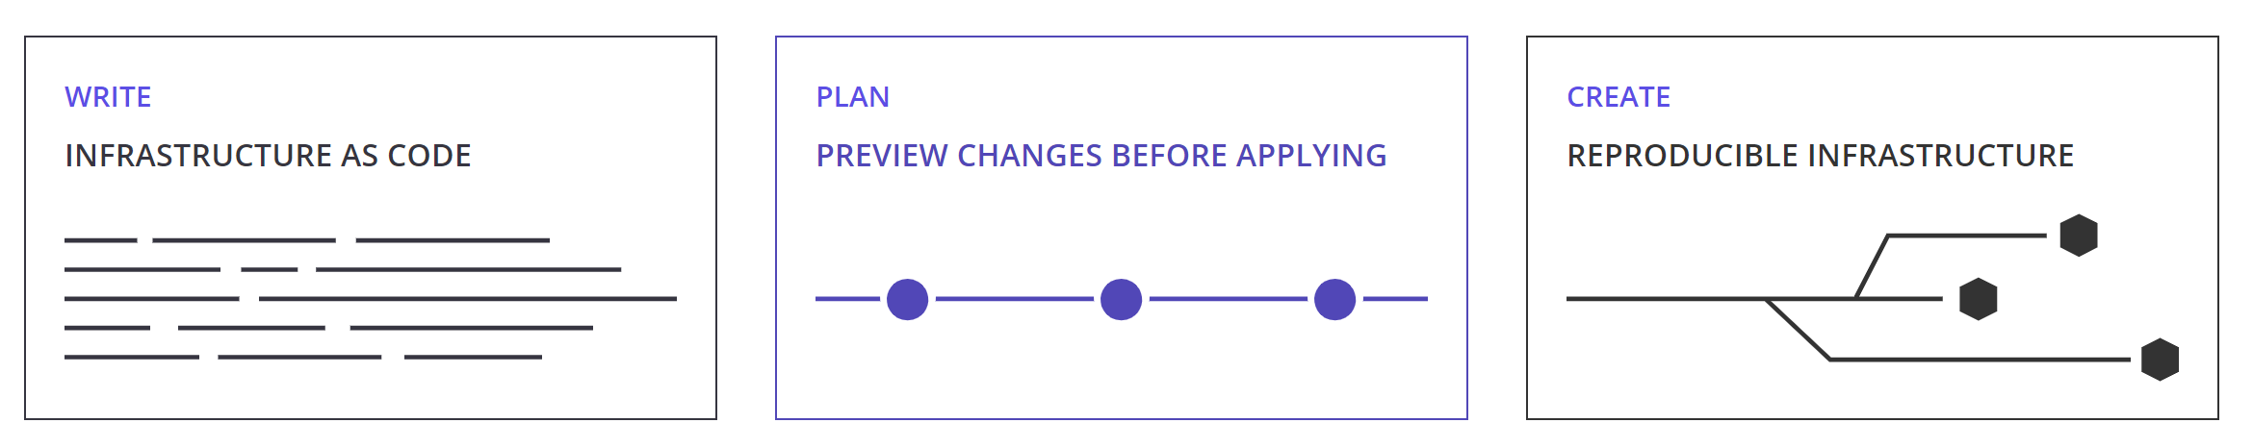
Why I chose Terraform?

Slide 11
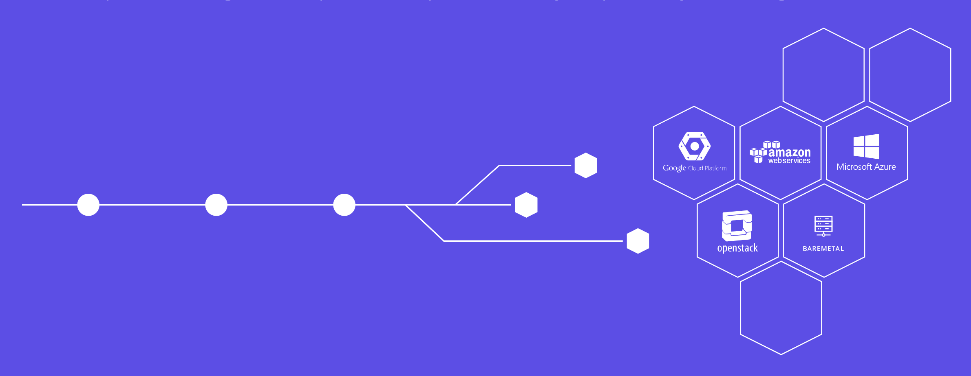
Why I chose Terraform?

Slide 12
Why I chose Terraform?
ACME, Alicloud, Archive, Arukas, AWS, Azure, Azure Active Directory, Azure Stack, Bitbucket, Brightbox, CenturyLinkCloud, Chef, Circonus, Cisco ASA, Cloudflare, CloudScale.ch, CloudStack, Cobbler, Consul, Datadog, DigitalOcean, DNS, DNSimple, DNSMadeEasy, Docker, Dyn, External, F5 BIG-IP, Fastly, FlexibleEngine, FortiOS, GitHub, Gitlab, Google Cloud Platform, Grafana, Gridscale, Hedvig, Helm, Heroku, Hetzner Cloud, HTTP, HuaweiCloud, Icinga2,Ignition, InfluxDB, JDCloud, Kubernetes, Librato, Linode, Local, Logentries, LogicMonitor, Mailgun, MySQL, Naver Cloud, Netlify, New Relic,Nomad, NS1, Null, Nutanix, 1&1, OpenStack, OpenTelekomCloud, OpsGenie, Oracle Cloud Infrastructure, Oracle Cloud Platform, Oracle Public Cloud, OVH, Packet, PagerDuty, Palo Alto Networks, PostgreSQL, PowerDNS, ProfitBricks, RabbitMQ, Rancher, Rancher2, Random, RightScale, Rundeck, RunScope, Scaleway, Selectel, Skytap, SoftLayer, Spotinst, StatusCake, TelefonicaOpenCloud, Template, TencentCloud, TLS, Triton, UCloud, UltraDNS, Vault, VMware NSX-T, VMware vCloud Director, VMware vRA7, VMware vSphere, Yandex
Providers

Slide 13
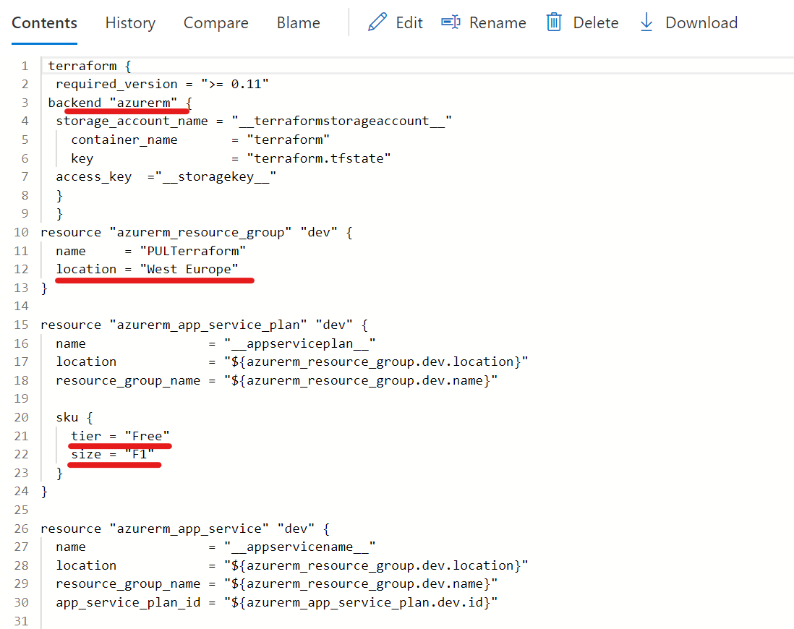
Why I chose Terraform?

Slide 14
“Life is too short and important to click next at every deployment”

Slide 15
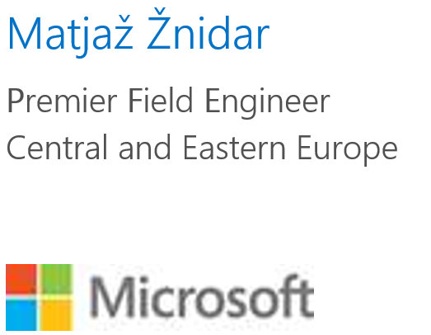
Few words about me
Follow me on Twitter → @MatjazZnidar
Visit my blog → https://m-12.net
Mail me → pfe.si@outlook.com
Stay curious and never stop learning!!
Thank you

Slide 16
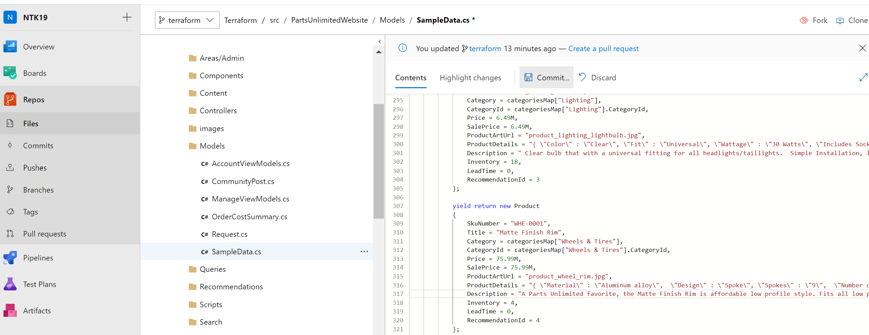
Demo

Slide 17
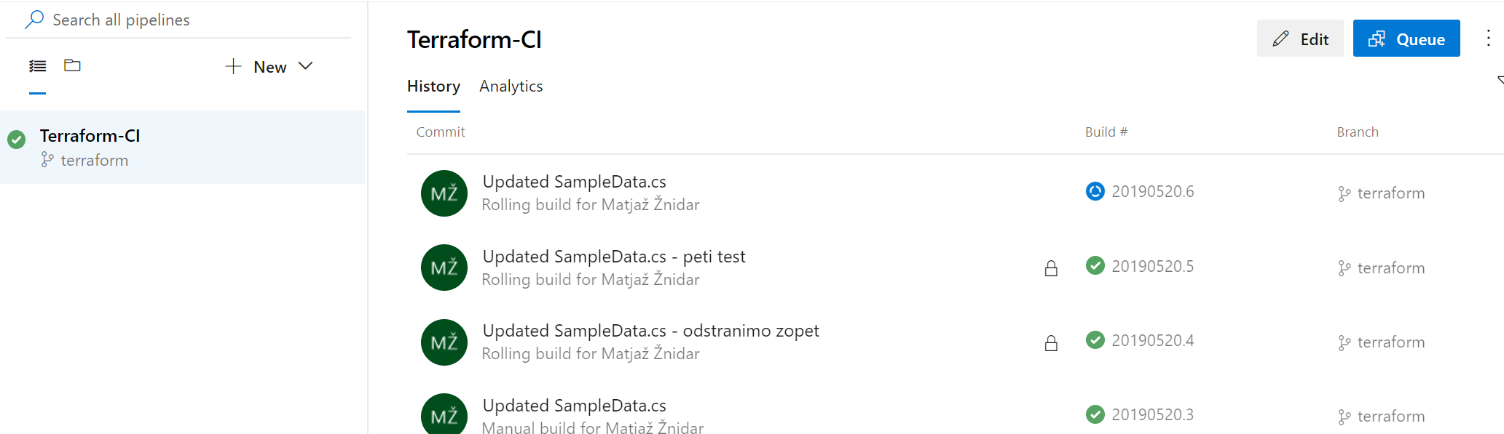
Demo

Slide 18
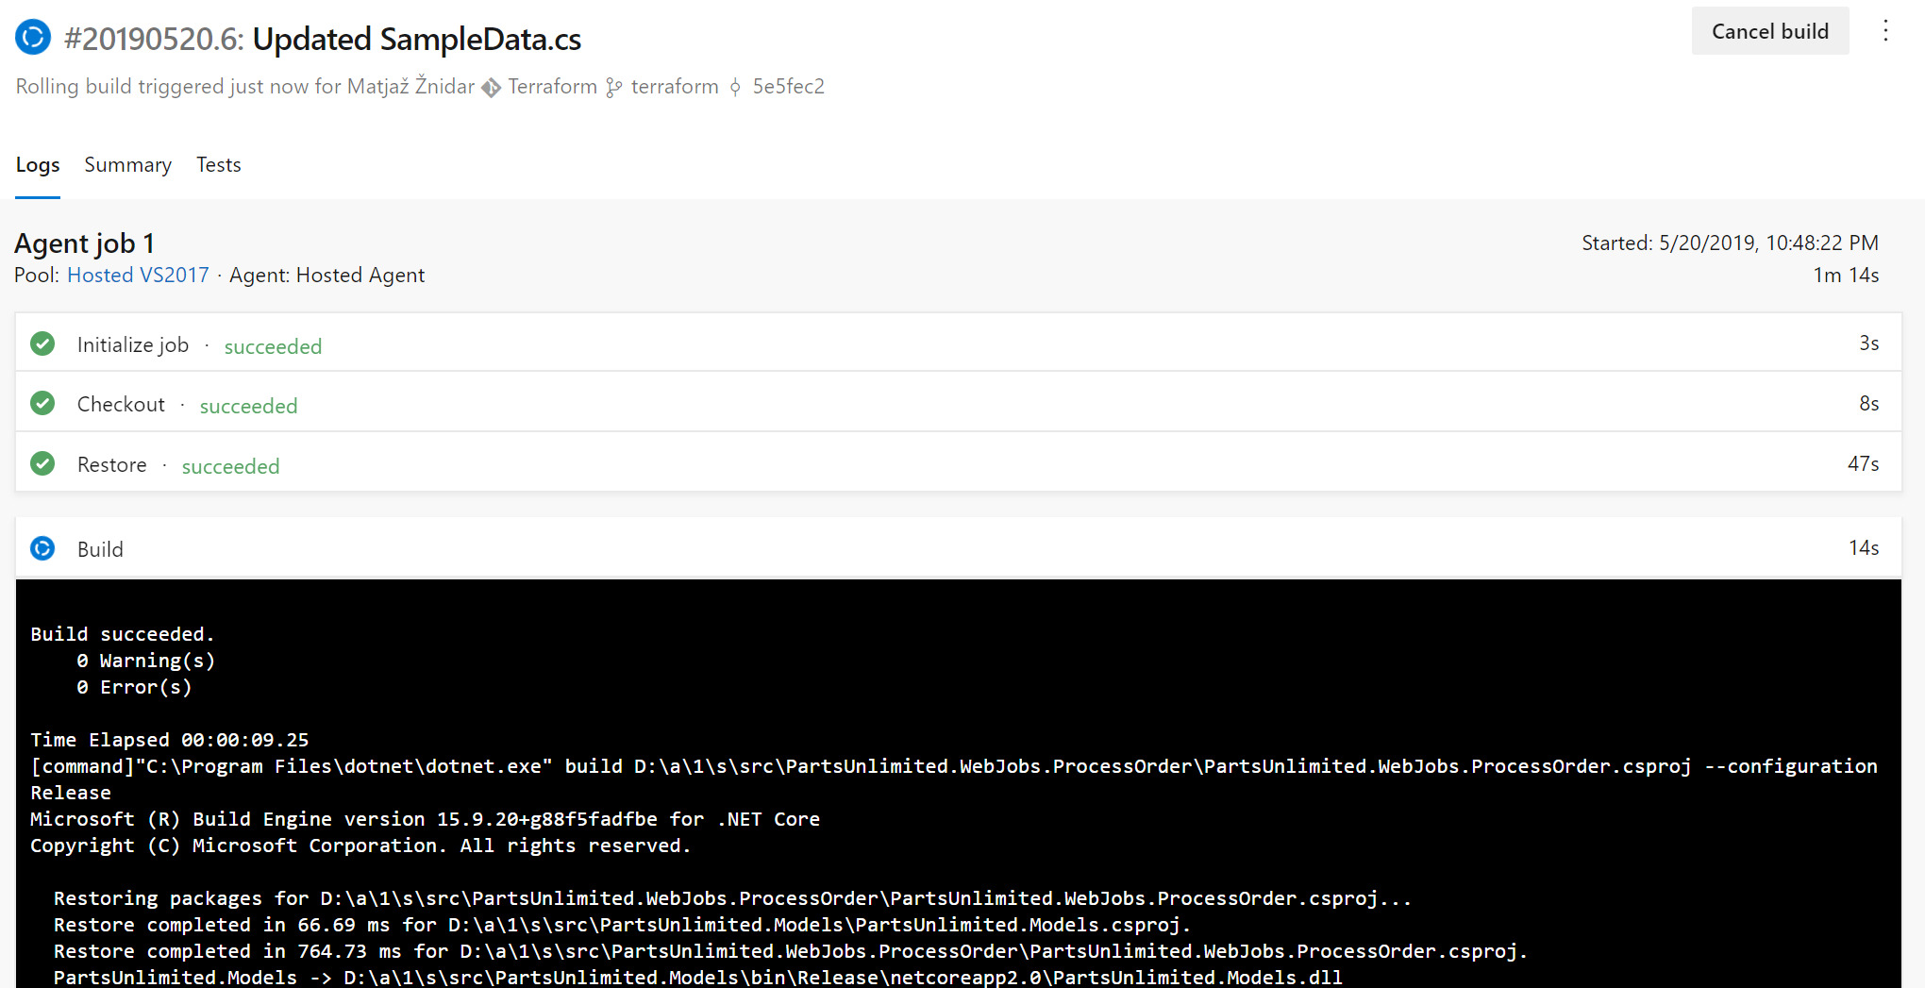
Demo

Slide 19
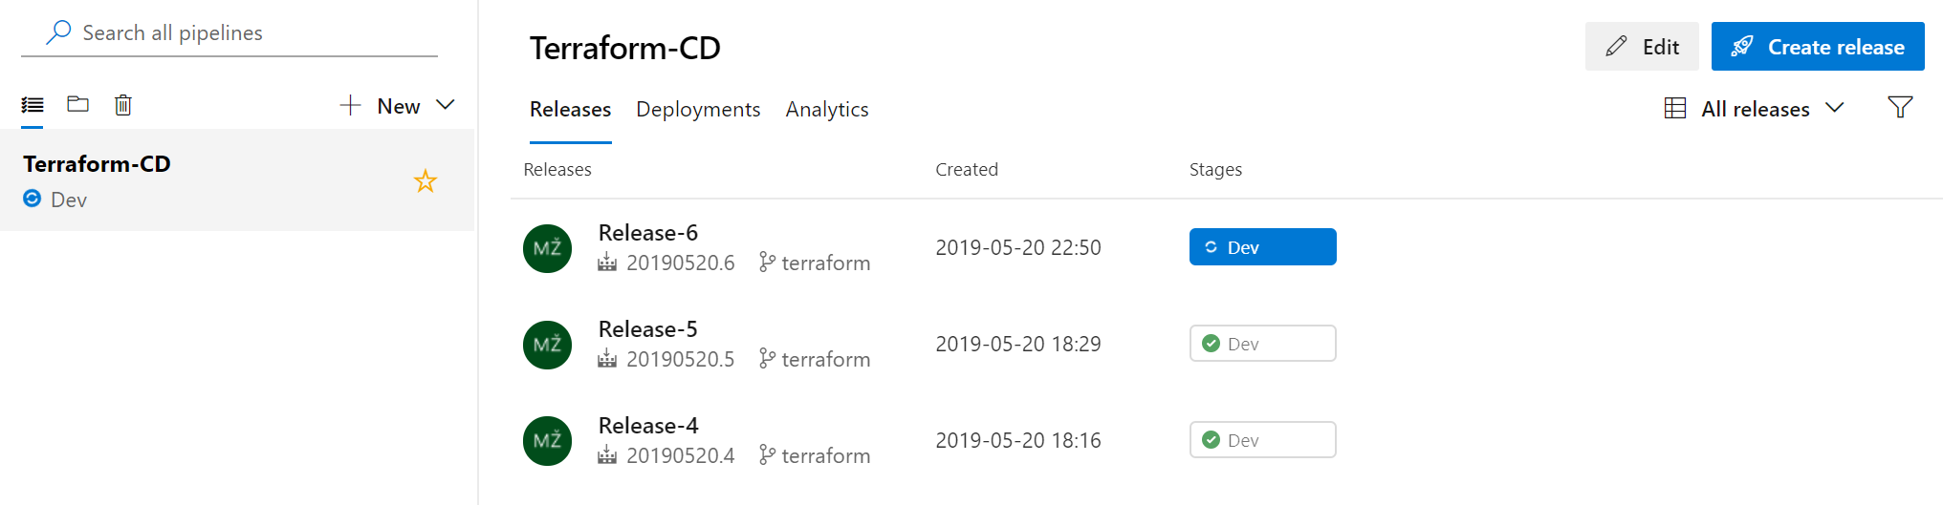
Demo

Slide 20
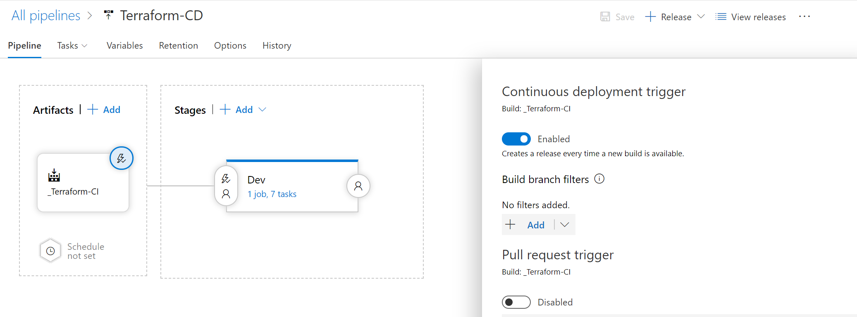
Demo

Slide 21
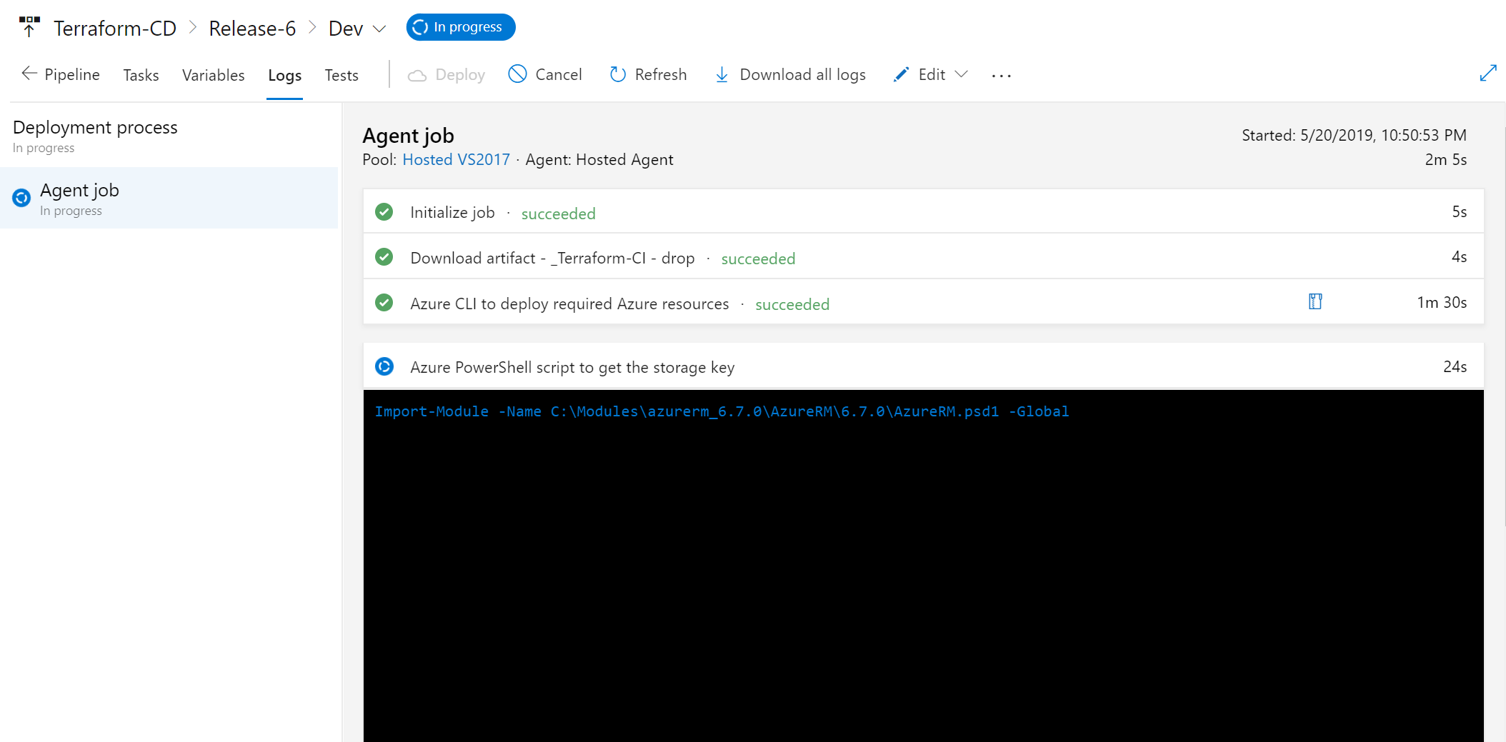
Demo

Slide 22
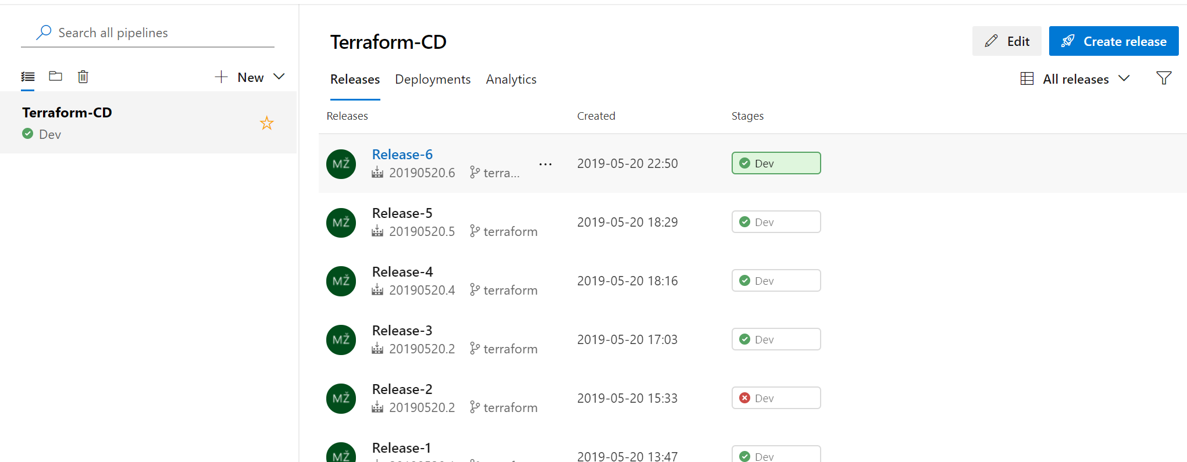
Demo

Slide 23
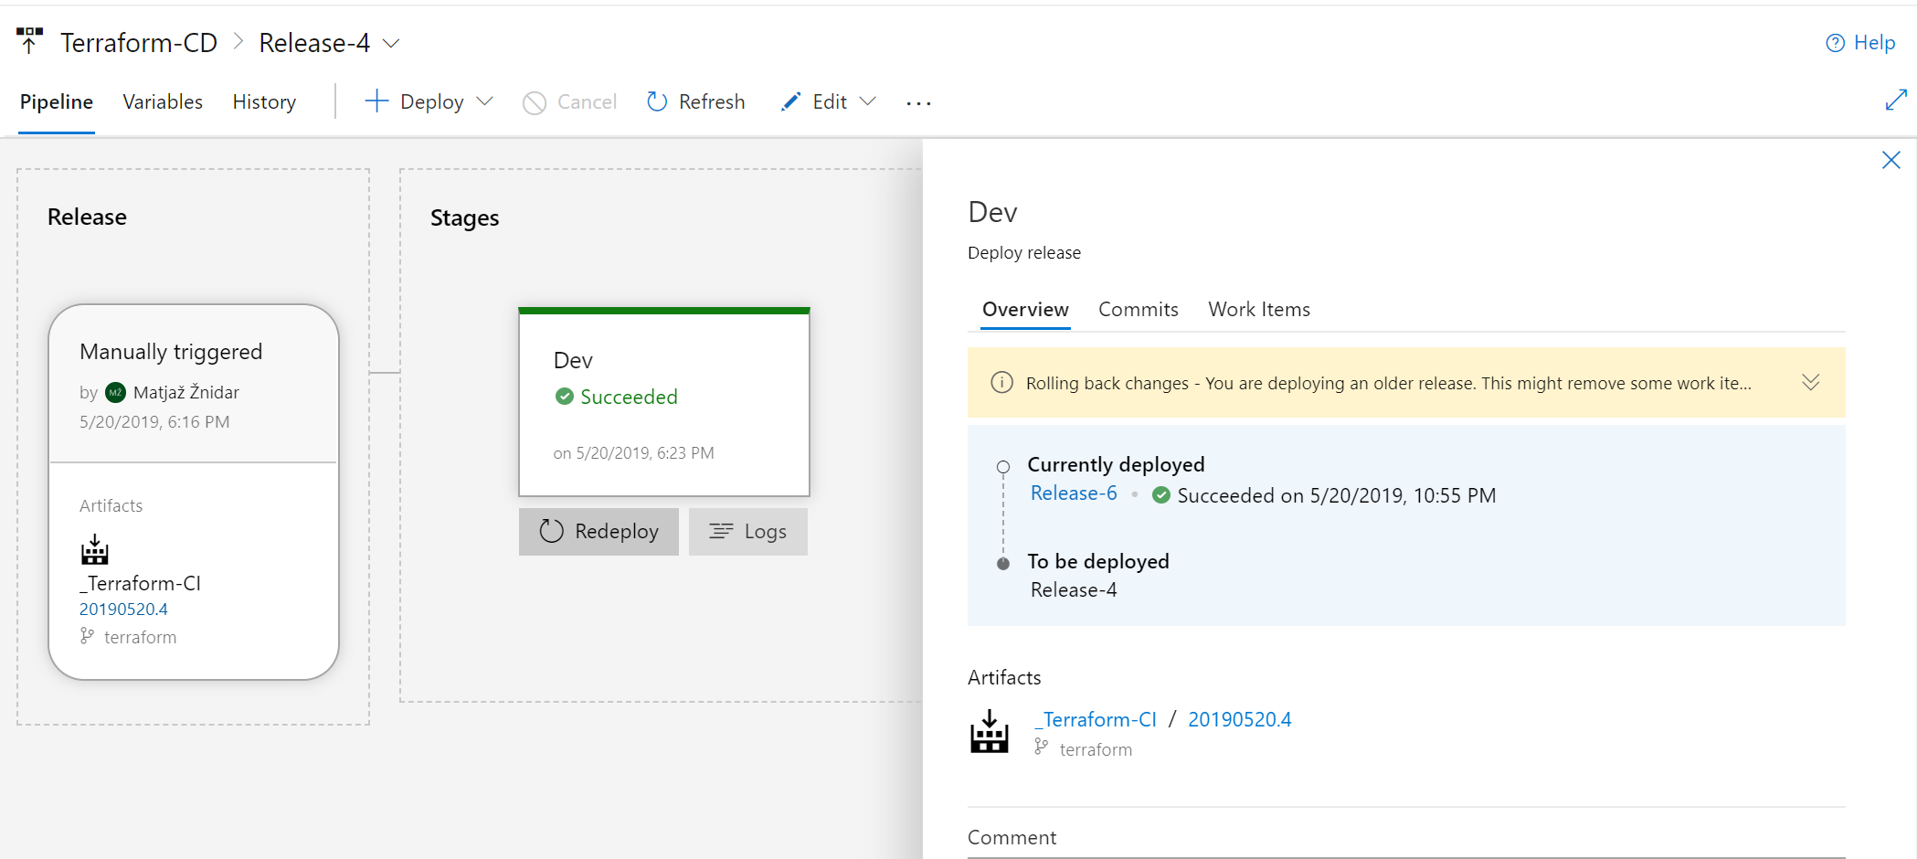
Demo

